Slide 1
The Logic of Experimental verifiability
Assumptions of Physics collaboration

Slide 2
Outline
Issue fundamental object (in math is a set)
Science is about describing the world, but not all descriptions of the world are science
Require -> Principle of scientific objectivity (examples of non-universal, contradictory, non-verifiable or semi-decidable)
Two parts: first solve non-contradiction, then solve evidence based
Statements
Problem of web of meaning, and idealization of statements (“conceptual cut”) -> statements being prime objects (i.e. unstructured)
Show the divide between formal and informal
Need justifications for axioms and definitions; axioms and definitions are chosen because they allow for simple justification (not because mathematicians like them)
Problems in capturing self-consistency (paradoxes, semantic and formal) -> Axiom of context
Truth is found experimentally, it has to be consistent with the meaning of the statements -> Axiom of possibility
Dependency between statements -> Axiom of closure
Logic operations, Equivalence (different equivalence), Boolean algebra, Narrowness and independence, minterms
Verifiable
Finite time verification (also idealization) – Not convenient to formalize the tests (knowing what is testable assumes knowing the laws of physics – circularity!)
Axiom of verifiability
Problem with NOT – falsifiable/decidable
Axioms of finite conjunction, countable disjunction
Summary of the logic

Slide 3
If we wanted to construct an axiomatic theory for all experimental science, what should our primitive notion be?

Slide 4

Principle of scientific objectivity: science is universal, non-contradictory and evidence based.
Guiding principle
Suggest logic as fundamental …
Universal $→$ same for everybody
like mathematics!
Non-contradictory $→$ something is either true or false
Evidence based $→$ truth is determined experimentally
… with some extensions
$⇒$ Logic of experimentally verifiable statements!

Slide 5
Logic of statements

Slide 6
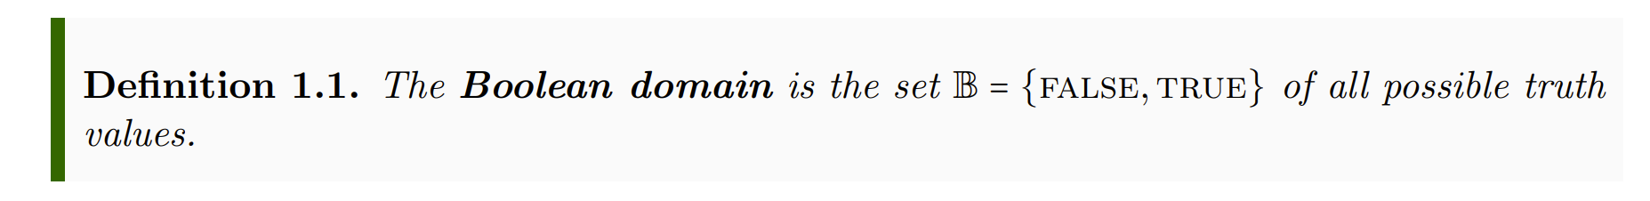
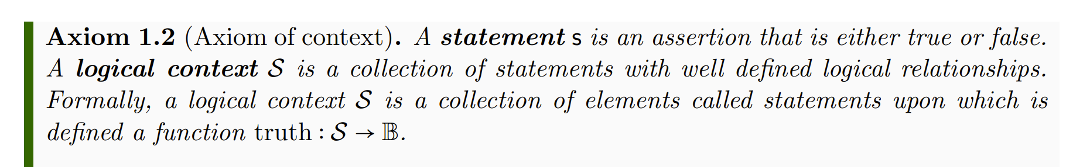
Informal part
Formal part
Informal
Formal
Each axiom/definition has two parts:
Informal part: tells us what elements in the physical world we are characterizing
Formal part: how the elements are characterized mathematically
physics
math
Each axiom/definition has a justification:
argues why the mathematical characterization follows from the physical one

Slide 7
Informal part
Formal part
Informal
Formal
Axiom: brings objects from the informal to the formal
physics
math
Definition: further specializes formal objects
Axioms/definitions should be formulated so that they are easy to justify…
… not so that they follow trends in mathematics

Slide 8

Informal part
Formal part
Informal
Formal
Physical objects are made “mathematically precise” by throwing out everything that can’t be made precise
physics
math
Syntax, grammar, meaning, … can’t be made precise, so are not part of the formal system
$⇒$ Statements are primitive objects

Slide 9
Informal part
Formal part
In mathematics, primitive objects (i.e. those that are left unspecified) must be elements of a set. The logical context, then, has two functions:
1) in the formal system, it is the “container” for the primitive objects (i.e. the statements)
2) in the informal system, consistency/semantic/… are properties of groups of statements (i.e. of the context)

Slide 10
Informal part
Formal part
A statement here represents the assertion and not the sentence that declares the assertion. Therefore the translation of a sentence into another languages represents the same statement.
Technically, we only assume the existence of valid statements for doing science. Therefore statements are also primitives in the informal system.
But if they exist, they must follow the axioms we are going to specify.

Slide 11

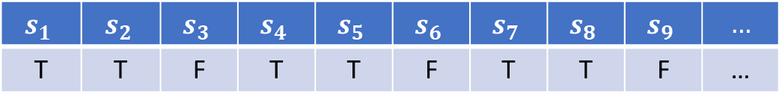

Informal part
Formal part
The existence of a truth function stems from the assumption of non-contradiction and universality.
Every statement must be either true or false for everybody.
$$𝒮$$
$$s_{1}$$ | $$s_{2}$$ | $$s_{3}$$ | $$s_{4}$$ | $$s_{5}$$ | $$s_{6}$$ | $$s_{7}$$ | $$s_{8}$$ | $$s_{9}$$ | $$…$$
T | T | F | T | T | F | T | T | F | …
$$truth$$
Context $⇒$ big table where statements are columns

Slide 12
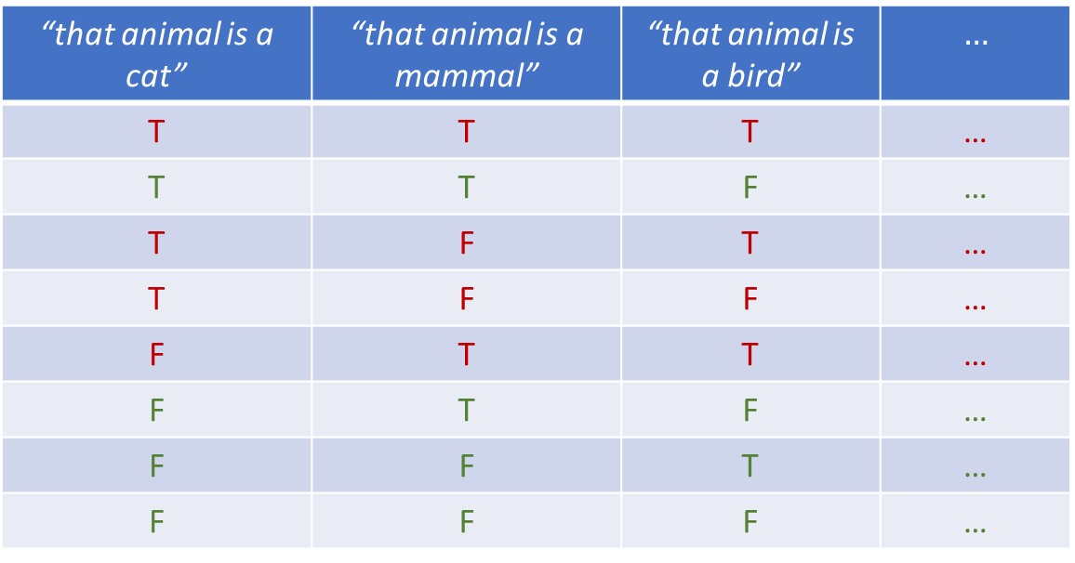
Note: the semantic content constrains the possible combinations of truth values
“that animal is a cat” | “that animal is a mammal” | “that animal is a bird” | $$…$$
T | T | T | …
T | T | F | …
T | F | T | …
T | F | F | …
F | T | T | …
F | T | F | …
F | F | T | …
F | F | F | …
impossible
The only semantics captured by the formal system is the set of possible combinations of truth values
Notes:
Part of the semantic content of the statements is captured by what truth value can be assigned; Possible assignments are determined by the semantic content of the statements

Slide 13
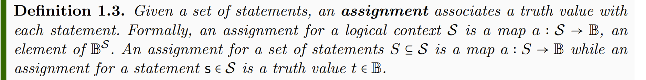


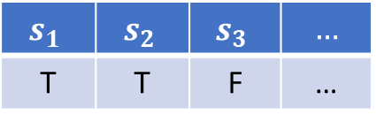

$$s_{1}$$ | $$s_{2}$$ | $$s_{3}$$ | $$…$$
T | T | F | …
$$a$$
assignment for whole context
$a{\left.​\right|}_{\left\{s_{1},s_{2}\right\}}$
$$a(s_{3})$$
assignment for a set of statements
assignment for a single statement
Notes:
TODO: Add a … after the third statement

Slide 14
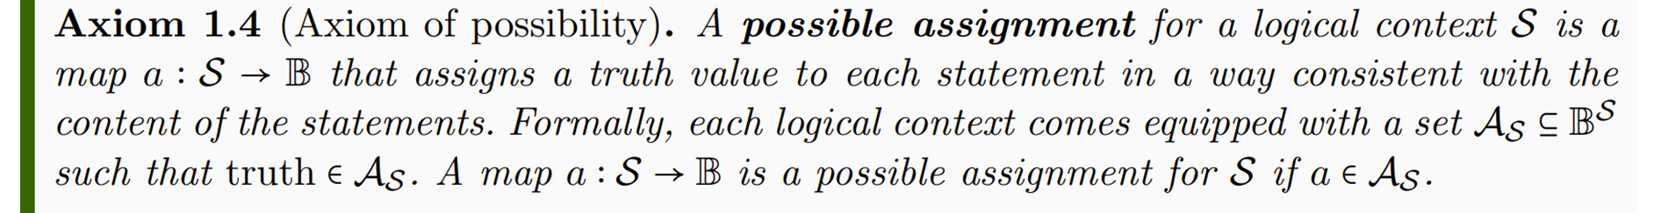


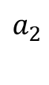

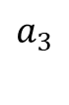


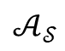
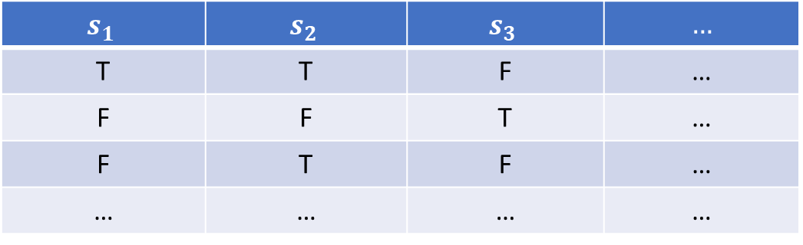
$$s_{1}$$ | $$s_{2}$$ | $$s_{3}$$ | $$…$$
T | T | F | …
F | F | T | …
F | T | F | …
… | … | … | …
$$a_{1}$$
$$truth$$
$$a_{2}$$
$$𝒜_{𝒮}$$
$$a_{3}$$
$$…$$
Possible assignment are those assignment consistent with the meaning (semantics) of the statements
Context $⇒$ big table where statements are columns and possible assignments are rows

Slide 15
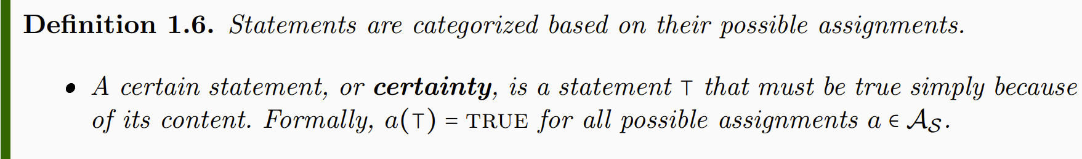
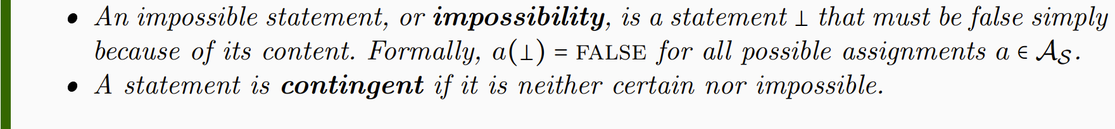
“that cat is a mammal” | “that mammal is a cat” | “that mammal is a bird”
T | T | F
T | F | F
certain
contingent
impossible
Certainties and impossibilities have the same truth value in all rows
Notes:
NOTE: whether a statement is a certainty or not depends on context. Mass of the electron: contingent if measuring the mass, certainty for particle identification

Slide 16

Whether a statement is certain or contingent depends on context!
the mass of the electron is 510 $±$ 0.5 KeV
Contingent when measuring the mass of the electron
Certain when performing
particle identification
Notes:
NOTE: whether a statement is a certainty or not depends on context. Mass of the electron: contingent if measuring the mass, certainty for particle identification

Slide 17
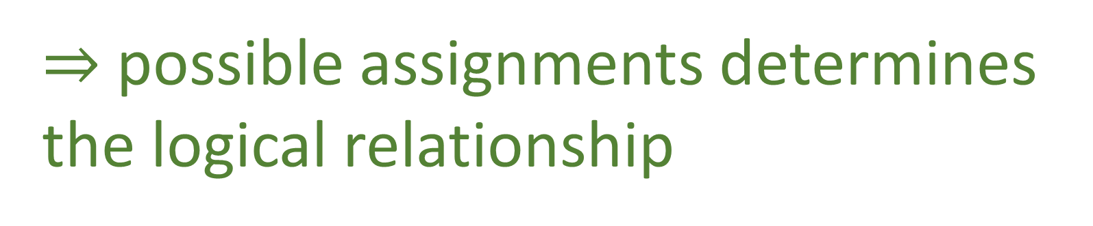
Some statements depend on other statements
That animal is a mammal
That animal has feathers
incompatible
narrower
equivalent
That animal is a cat
That animal is a bird
independent
That animal is black
negation
That animal is not black
$⇒$ possible assignments determines the logical relationship
Notes:
Want to keep track whether the truth of one statement depends on the truth of others: function on truth values – introduce truth tables

Slide 18
Equivalent
Independent
“that animal has feathers” | “that animal is a bird”
T | T
T | F
F | T
F | F
 | T | F
T | ü | û
F | û | ü
“that animal is a cat” | “that animal is black”
T | T
T | F
F | T
F | F
 | T | F
T | ü | ü
F | ü | ü
Incompatible
“that animal is a mammal” | “that animal is a bird”
T | T
T | F
F | T
F | F
 | T | F
T | û | ü
F | ü | ü

Slide 19
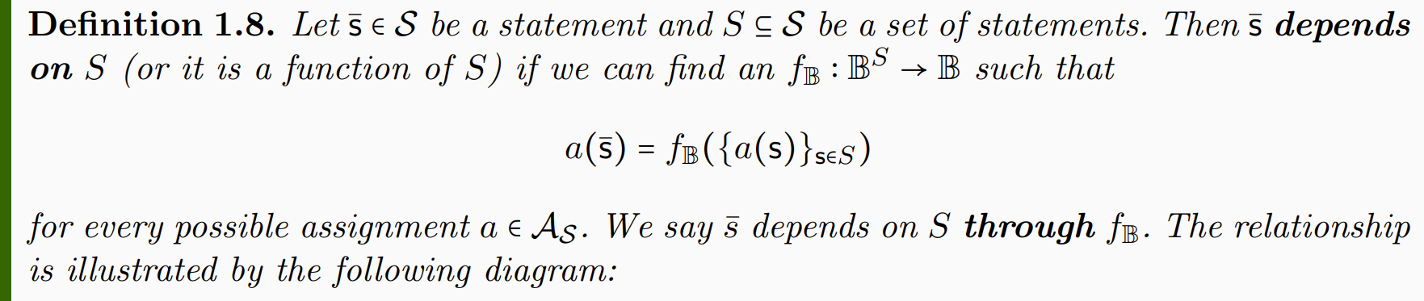










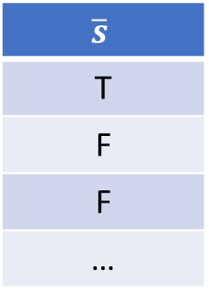



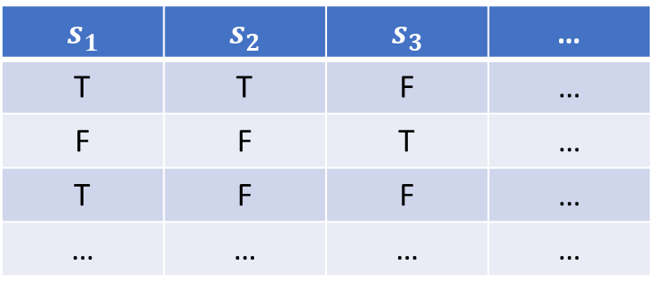


$$s_{1}$$ | $$s_{2}$$ | $$s_{3}$$ | …
T | T | F | …
F | F | T | …
T | F | F | …
… | … | … | …
…
…
…
…
…
$$\overline{s}$$
T
F
F
…
$$a_{1}$$
$a_{1}$($\overline{s})=$ $f_{𝔹}(a_{1}(s_{1})$, $a_{1}(s_{2}$), $a_{1}(s_{3}$))
$$a_{2}$$
$$f_{𝔹}$$
$a_{2}$($\overline{s})$= $f_{𝔹}(a_{2}(s_{1})$, $a_{2}(s_{2}$), $a_{2}(s_{3}$))
$$𝒜_{𝒮}$$
$$a_{3}$$
$s_{1}$ AND ${(s}_{2} OR{ s}_{3})$
$a_{3}$($\overline{s})$= $f_{𝔹}(a_{3}(s_{1})$, $a_{3}(s_{2}$), $a_{3}(s_{3}$))
$$…$$
$f_{𝔹}$(…,…,…)
$$S$$
$s_{1}$=“that animal is a cat”
$s_{2}$=“that animal is a mammal”
$s_{3}$=“that animal is a bird”
Notes:
Applying truth tables to the assignments

Slide 20
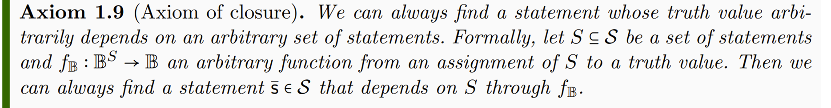


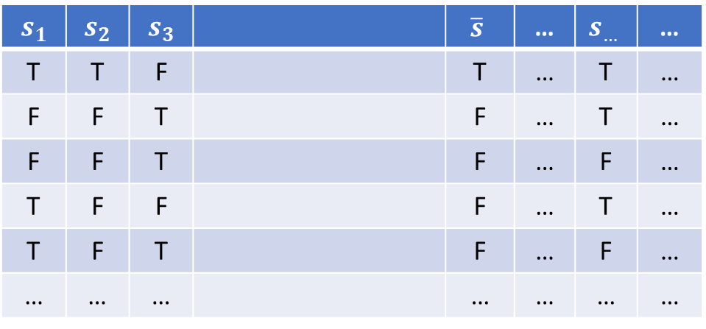
$$s_{1}$$ | $$s_{2}$$ | $$s_{3}$$ |  | $$\overline{s}$$ | … | $$s_{…}$$ | …
T | T | F |  | T | … | T | …
F | F | T |  | F | … | T | …
F | F | T |  | F | … | F | …
T | F | F |  | F | … | T | …
T | F | T |  | F | … | F | …
… | … | … |  | … | … | … | …
Not sure whether it is needed as an axiom: the closure may be proven to exist and be unique.
$$f_{𝔹}$$
$s_{1}$ AND ${(s}_{2} OR{ s}_{3})$
Notes:
The logical context will allows allow all possible truth functions

Slide 21
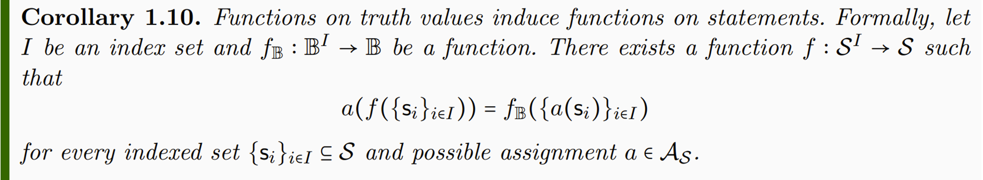

$$f(s_{1},s_{2},s_{3})$$
$$s_{1}$$ | $$s_{2}$$ | $$s_{3}$$ |  | $$\overline{s}$$ | … | $$s_{…}$$ | …
T | T | F |  | T | … | T | …
F | F | T |  | F | … | T | …
F | F | T |  | F | … | F | …
T | F | F |  | F | … | T | …
T | F | T |  | F | … | F | …
… | … | … |  | … | … | … | …
$$f_{𝔹}$$
$s_{1}$ AND ${(s}_{2} OR{ s}_{3})$
Notes:
-> Functions on truth values induce functions on statements

Slide 22
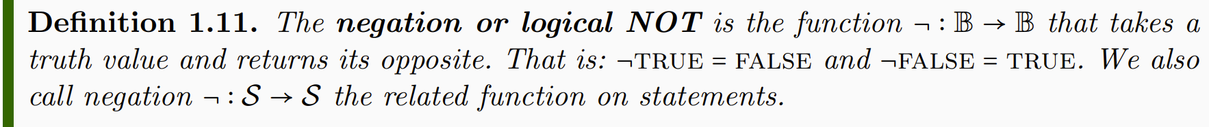


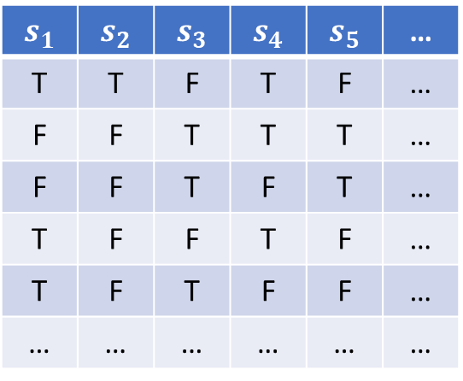
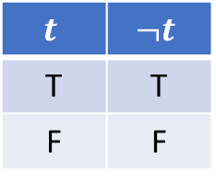
$$t$$ | $$¬t$$
T | T
F | F
$$s_{1}$$ | $$s_{2}$$ | $$s_{3}$$ | $$s_{4}$$ | $$s_{5}$$ | …
T | T | F | T | F | …
F | F | T | T | T | …
F | F | T | F | T | …
T | F | F | T | F | …
T | F | T | F | F | …
… | … | … | … | … | …
That animal is a cat
$$¬$$
That animal is not a cat
$$¬$$

Slide 23
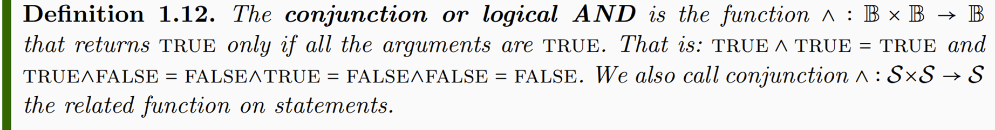
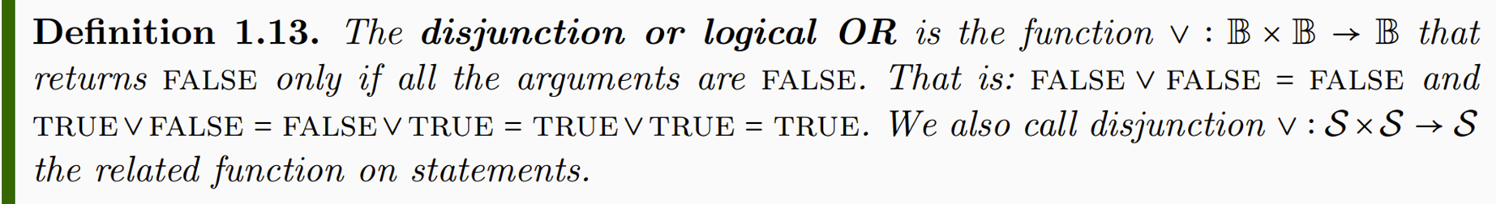
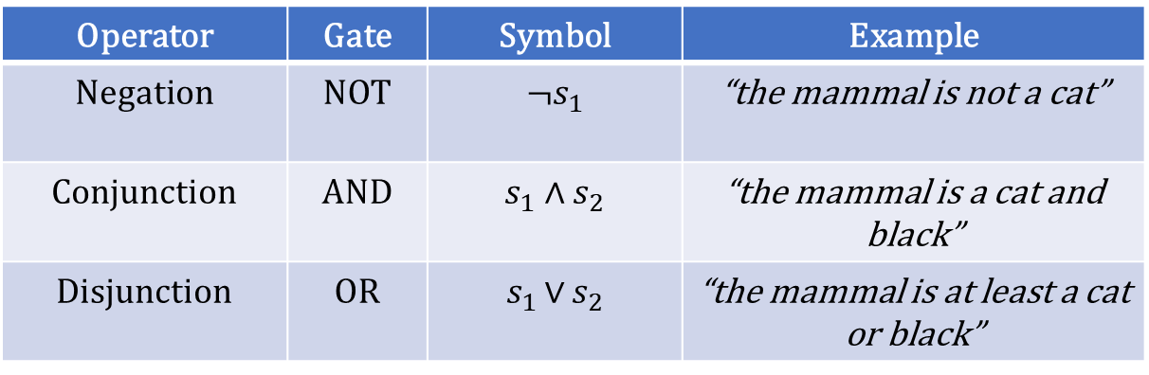
Operator | Gate | Symbol | Example
Negation | NOT | ¬$s_{1}$ | “the mammal is not a cat”
Conjunction | AND | $$s_{1} \text{∧ }s_{2}$$ | “the mammal is a cat and black”
Disjunction | OR | $s_{1 }\text{∨}$ $s_{2}$ | “the mammal is at least a cat or black”

Slide 24
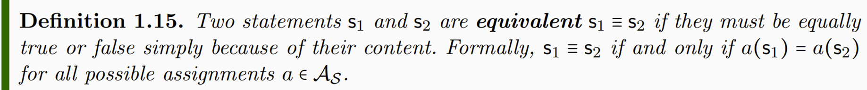
Notes:
Different notion of equivalence Table 1.2

Slide 25
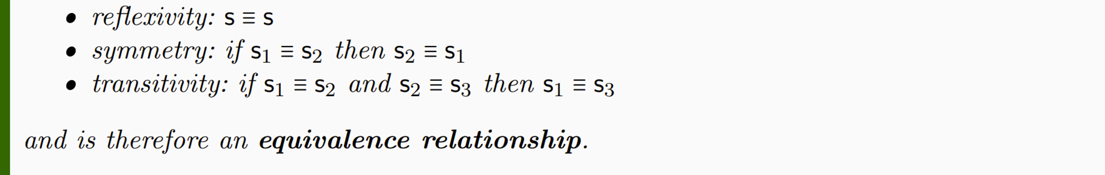
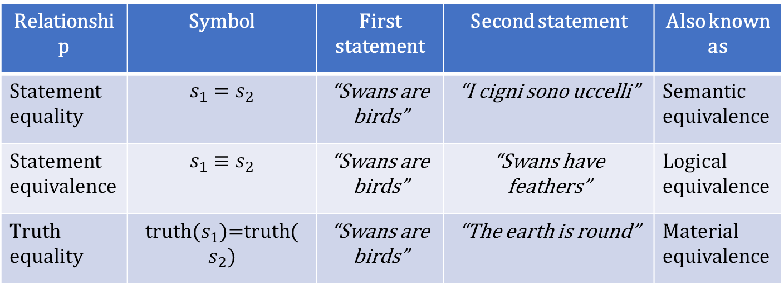
Relationship | Symbol | First statement | Second statement | Also known as
Statement equality | $$s_{1}=s_{2}$$ | “Swans are birds” | “I cigni sono uccelli” | Semantic equivalence
Statement equivalence | $$s_{1}≡s_{2}$$ | “Swans are birds” | “Swans have feathers” | Logical equivalence
Truth equality | truth($s_{1}$)=truth($s_{2})$ | “Swans are birds” | “The earth is round” | Material equivalence

Slide 26
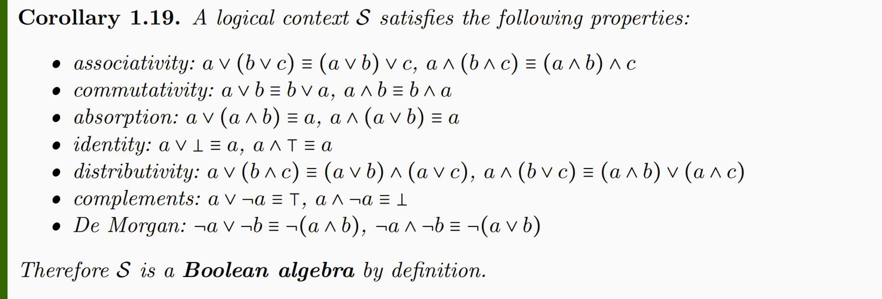

Slide 27
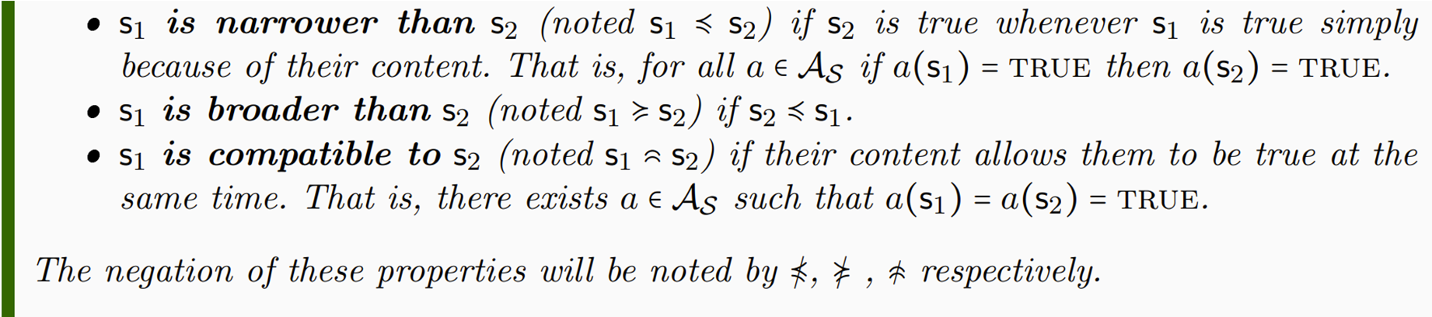
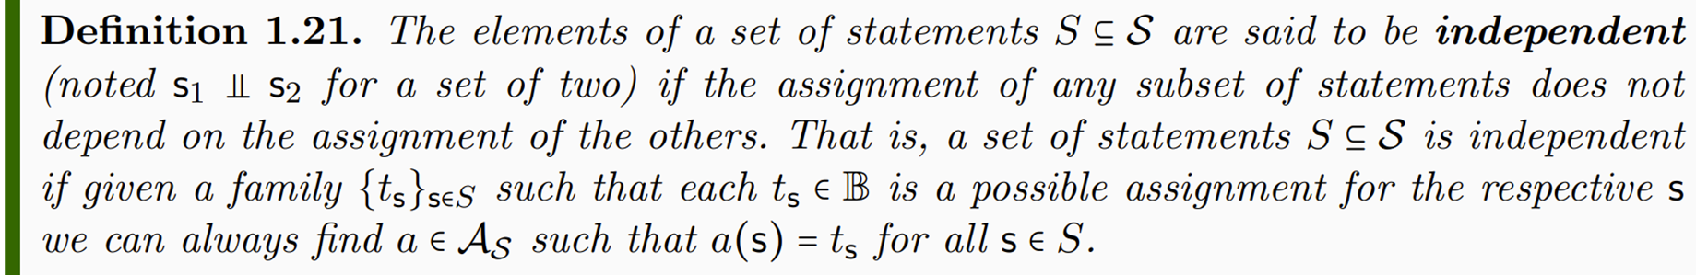

Slide 28
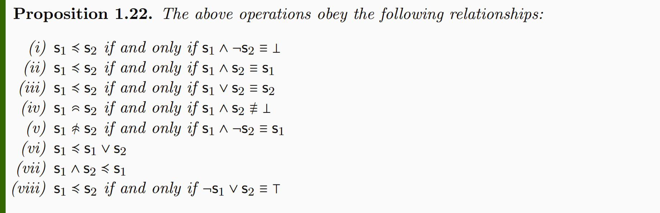

Slide 29
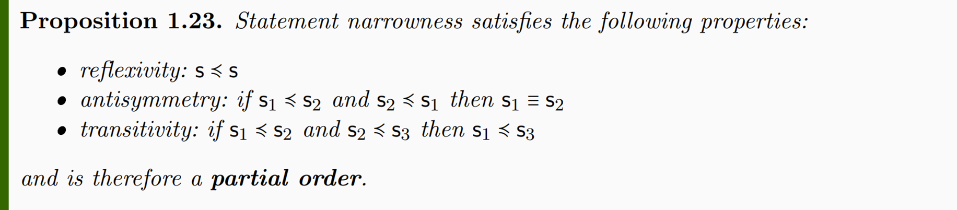
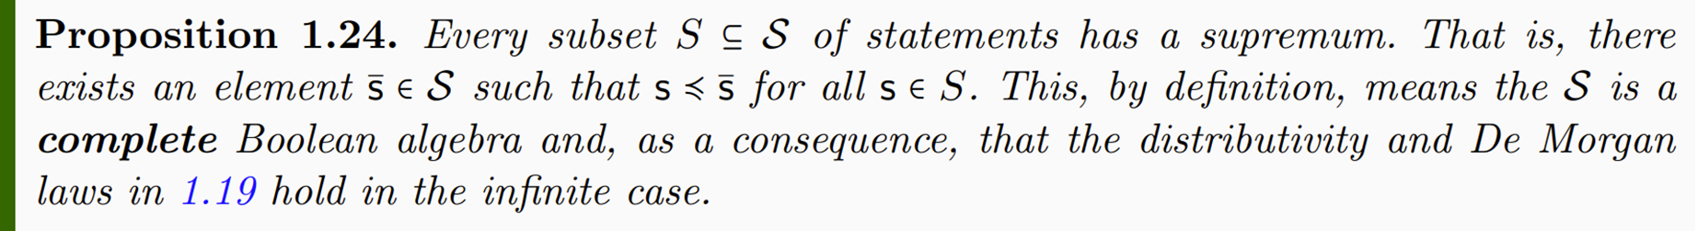
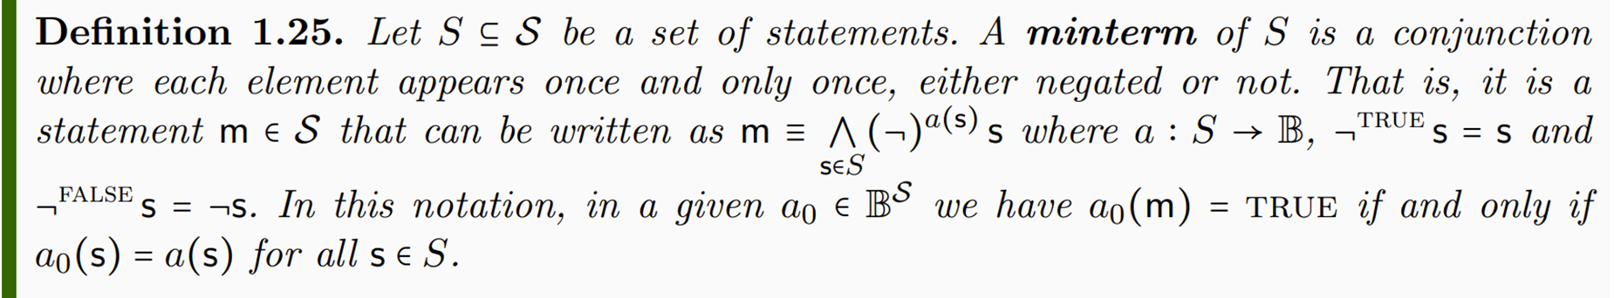

Slide 30
